Slide 1

Phase Transformations in Metals
Dr. J. Venkatramani
219-B
venkatramani@iiitdm.ac.in

Slide 2
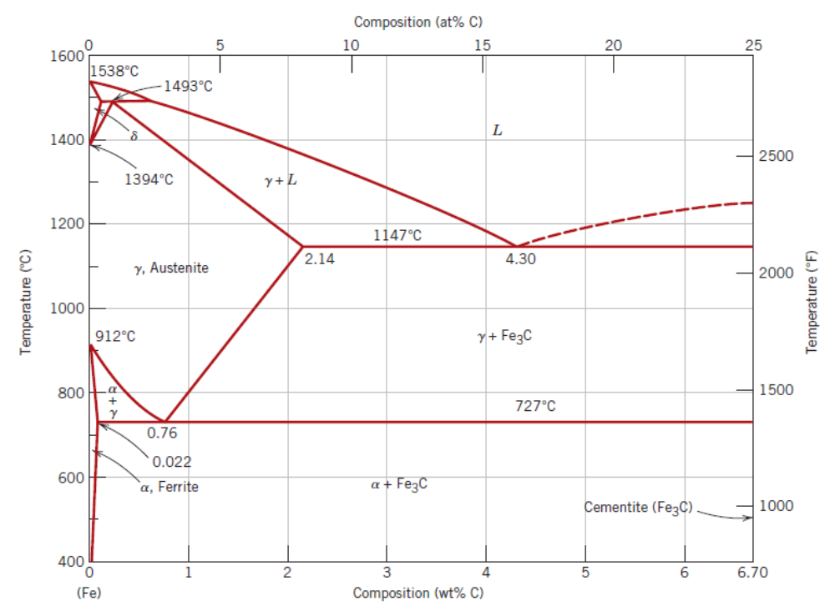
Metastable states vs Equilibrium states
Phase diagrams do not convey the time dependence of the phase structure formation.
Degree of transformation vs time or rate curves are helpful.
Exact equilibrium structures are practically not possible even for extremely slow cooling rates.
A metastable state between initial and equilibrium phase is obtained in most of the cases.
Sometimes desirable.

Slide 3
Basic concepts of Phase Transformations
Three kinds of phase transformations:
One that involves no change in either composition or number of phases and is diffusion dependent.
One that involves change in phase compositions or their numbers (say Eutectoid reaction) and is diffusion dependent.
Diffusionless phase transformation (metastable state)

Slide 4
Kinetics of Phase Transformations
Phase transformation process occurs primarily in two stages:
Nucleation of particles of the new phase
Growth of these particles
Two types of nucleation may be considered:
Homogenous and
Heterogeneous

Slide 5
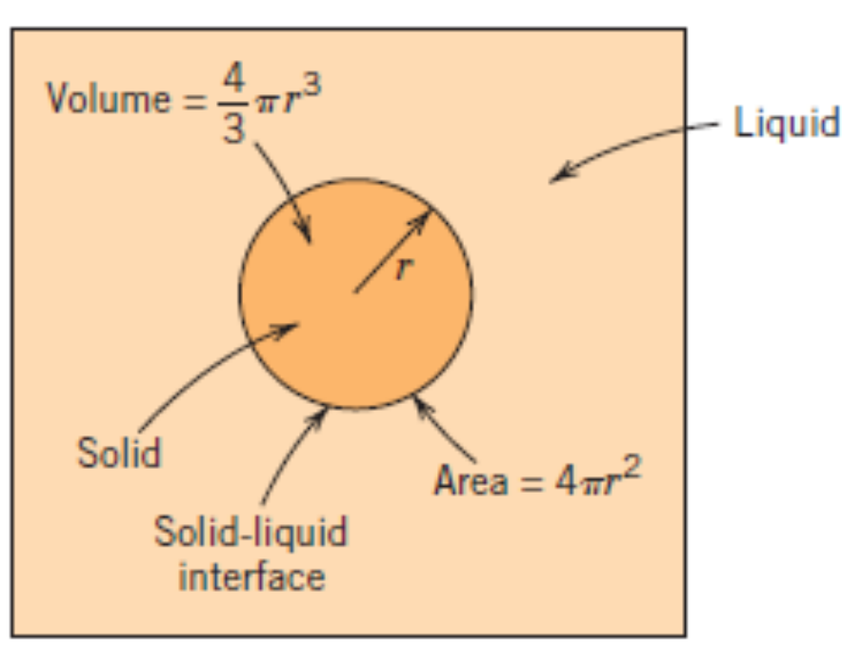
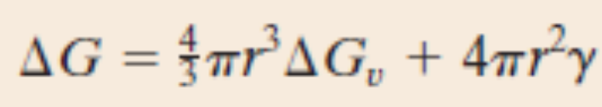
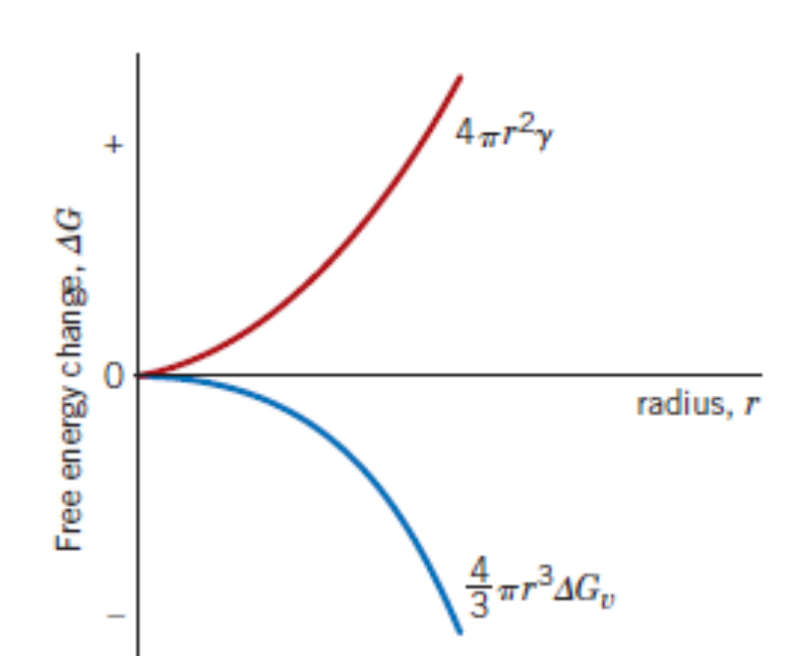
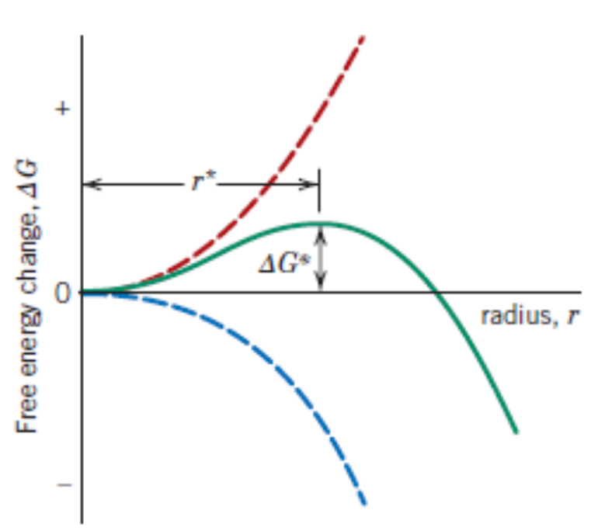
Homogeneous Nucleation
All the sites in the system are equally likely to be nucleation sites. Thus, even growth process also takes place uniformly at all of these sites.
All other variables (composition, temperature, pressure) must be uniform during the phase transformation process.
The process can be best described in terms of the Gibbs Free energy, which depends upon the enthalpy (H) and entropy (S) of the system.

Slide 6
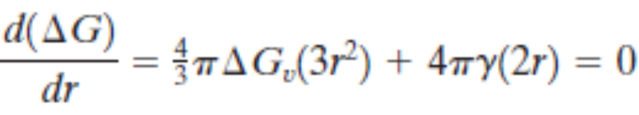
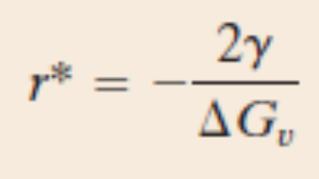
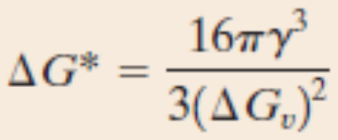
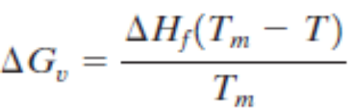
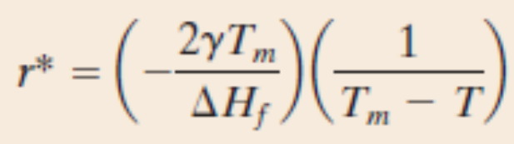
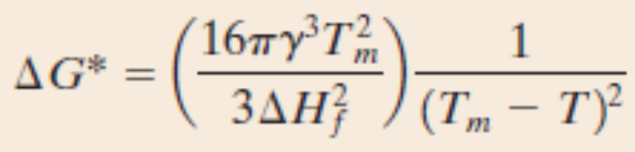
Homogeneous Nucleation

Slide 7
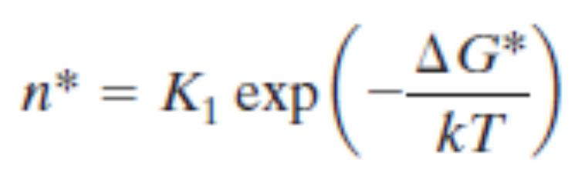
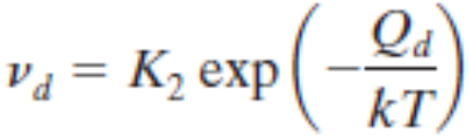
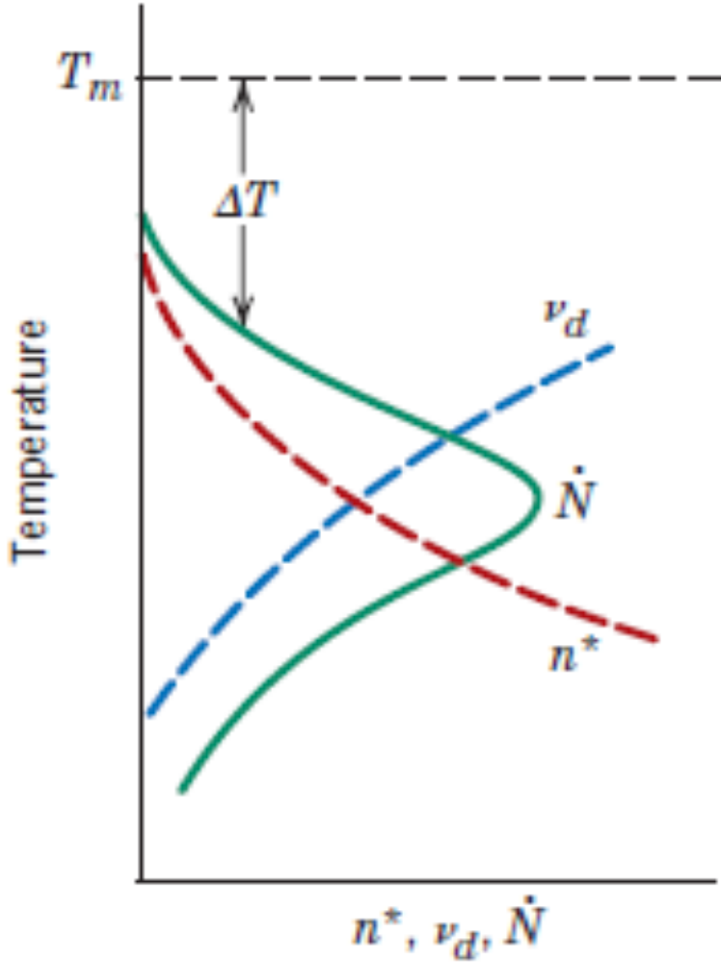
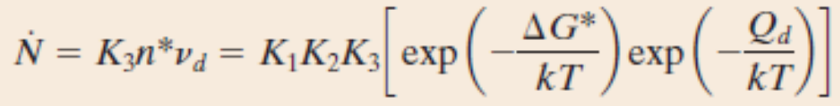
Homogeneous Nucleation

Slide 8
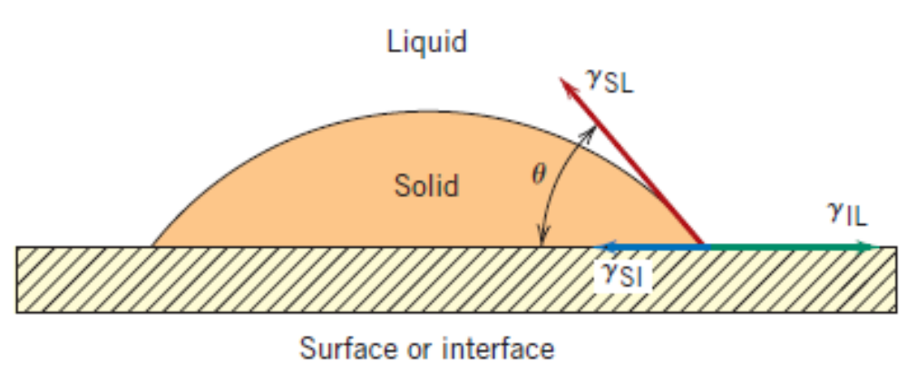
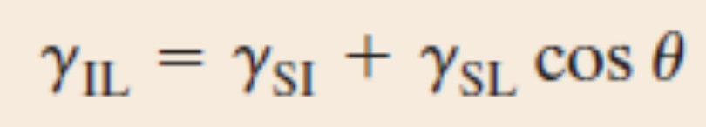
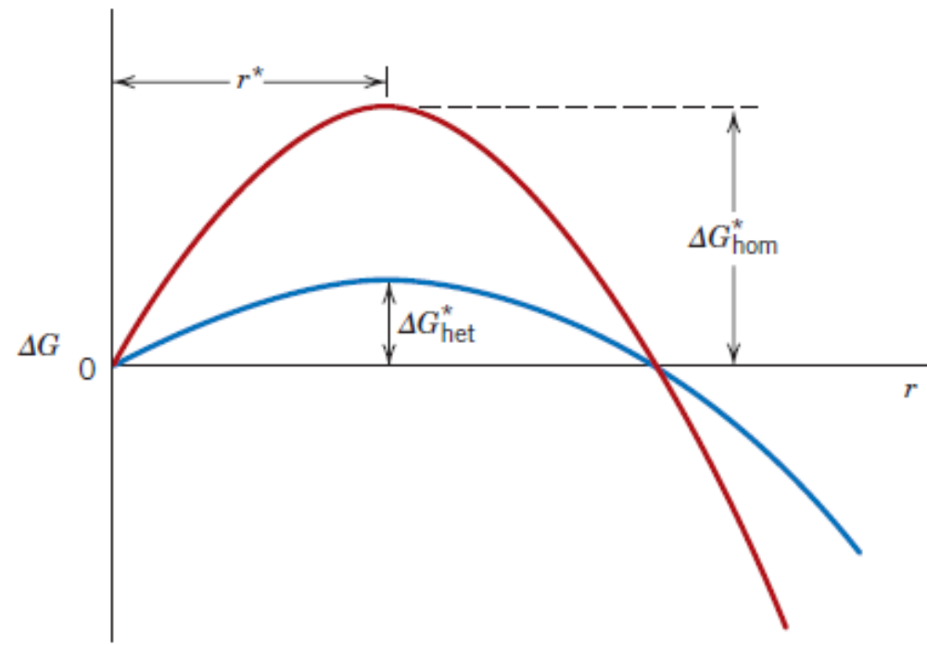
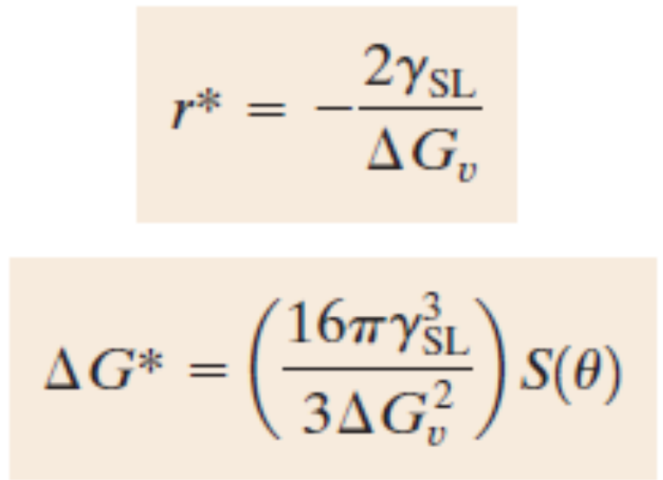
Heterogeneous Nucleation

Slide 9
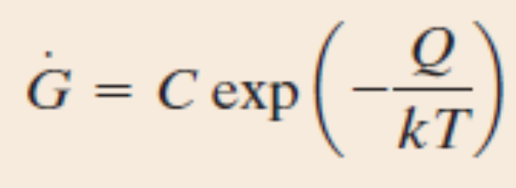
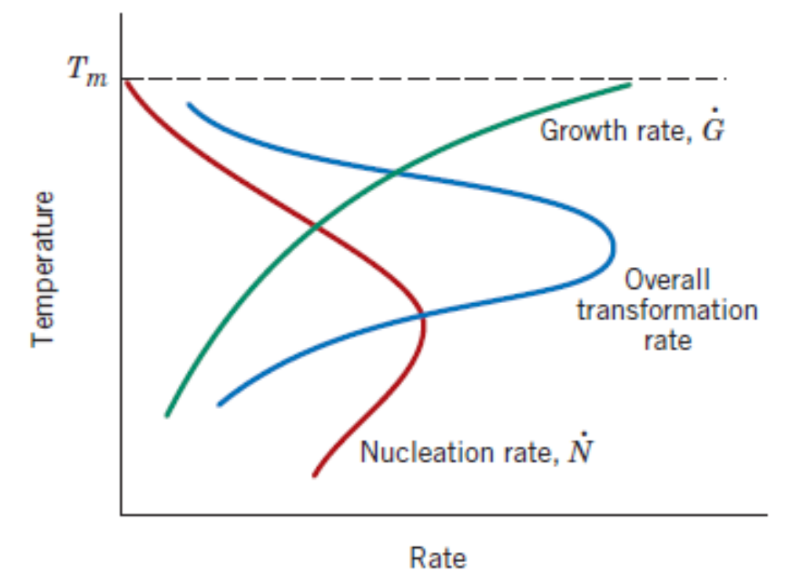
Growth
Growth happens by diffusion of atoms.
Diffusion through the phase, across the phase boundary and finally to the nucleus of the growing phase are the stages involved in growth process.

Slide 10
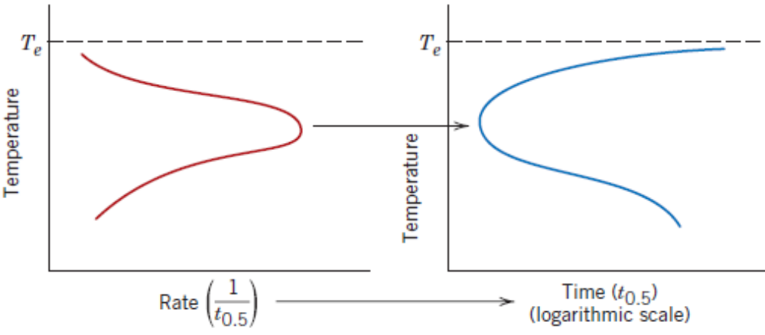
Growth
Time taken for completion of some degree of transformation and the rate of transformation are inversely related to each other.

Slide 11
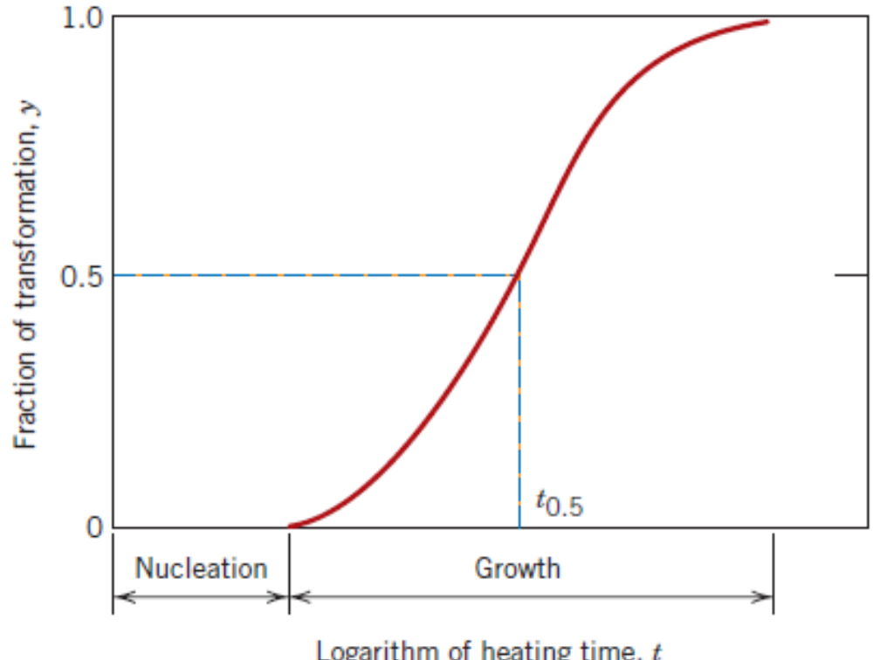
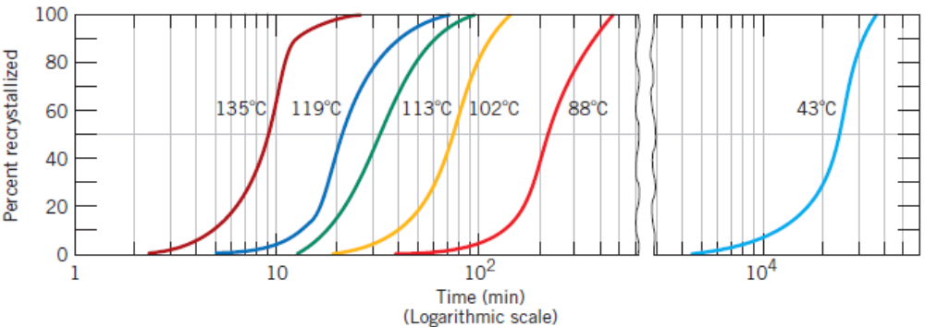
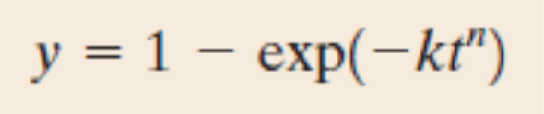
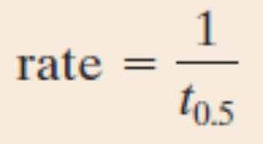
Kinetic Considerations in Solid – Solid Phase Transformations
It is necessary to study the kinetics of transformations in terms of times for which the heat treatments are carried out in Solid – Solid Transformations.
For pure Copper
Avraami equation

Slide 12
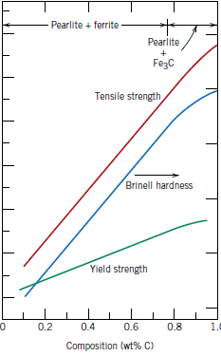
Mechanical Behaviour of Iron–Carbon Alloys
Strength – Resistance to deform permanently (plastic deformation).
Hardness – Resistance to localized plastic deformation (like dents, scratches etc).
Ductility – A measure of material’s capability to undergo large plastic deformations before fracture.
Pearlite:
Increasing Fe₃C will make the material more brittle and harder.

Slide 13
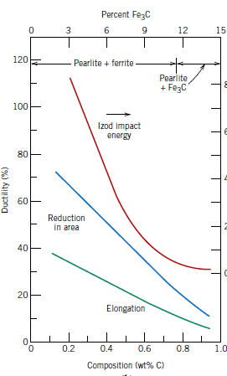
Mechanical Behaviour of Iron–Carbon Alloys
Strength – Resistance to deform permanently (plastic deformation).
Hardness – Resistance to localized plastic deformation (like dents, scratches etc).
Ductility – A measure of material’s capability to undergo large plastic deformations before fracture.
Pearlite:
Increasing Fe3C will make the material more brittle and harder.

Slide 14
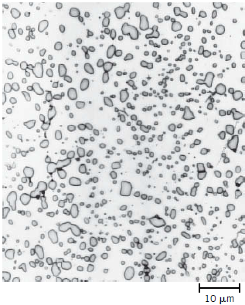
Mechanical Behaviour of Iron–Carbon Alloys
Spheroidite
Results when a pearlitic or bainitic structure is heated above Eutectoid and then cooled slowly. Slow enough to allow the Cementite phases to form spherical microstructures.
Slow cooling is done by keeping the sample below Eutectoid temperature for sufficiently long duration.
No change in composition of the phases.
Ferrite
Cementite

Slide 15
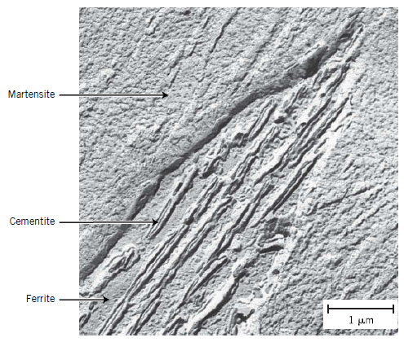
Mechanical Behaviour of Iron–Carbon Alloys
Bainite
Results when a austenite–pearlite transformation takes place at temperatures below 600⁰C.
Formation of needle like microstructure with cementite phases as needles, embedded in ferrite phase. This combination is in turn surrounded by Martentisite, another microstructure common in Iron – Carbon systems.
No change in composition of the phases.

Slide 16
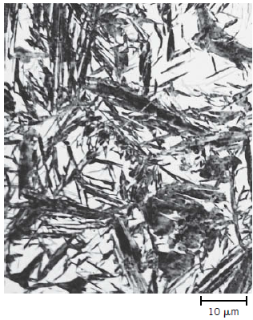
Mechanical Behaviour of Iron–Carbon Alloys
Martensite
Rapid cooling, called quenching of material to a temperature well below Eutectoid (say 300 – 600⁰C).

Slide 17
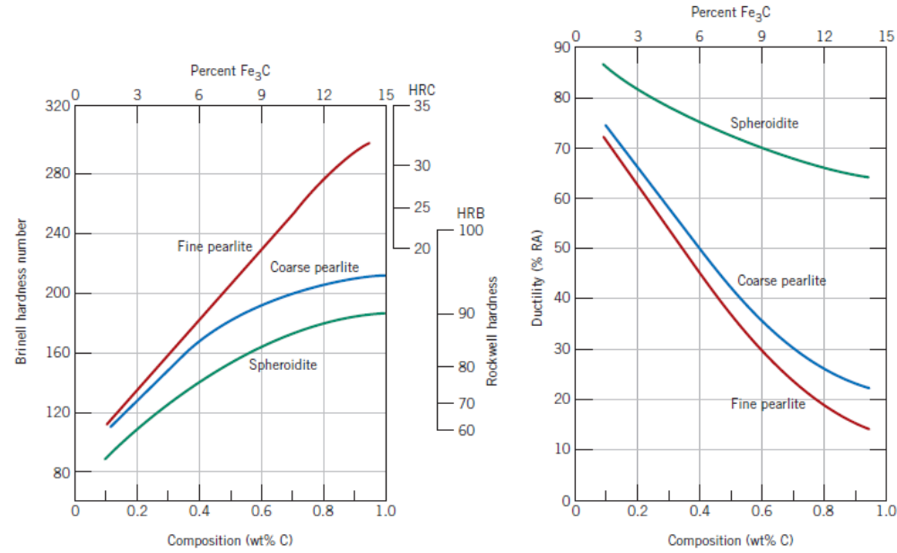
Mechanical Behaviour of Iron–Carbon Alloys
Fine Pearlite Vs Coarse Pearlite Vs Spheroidite

Slide 18
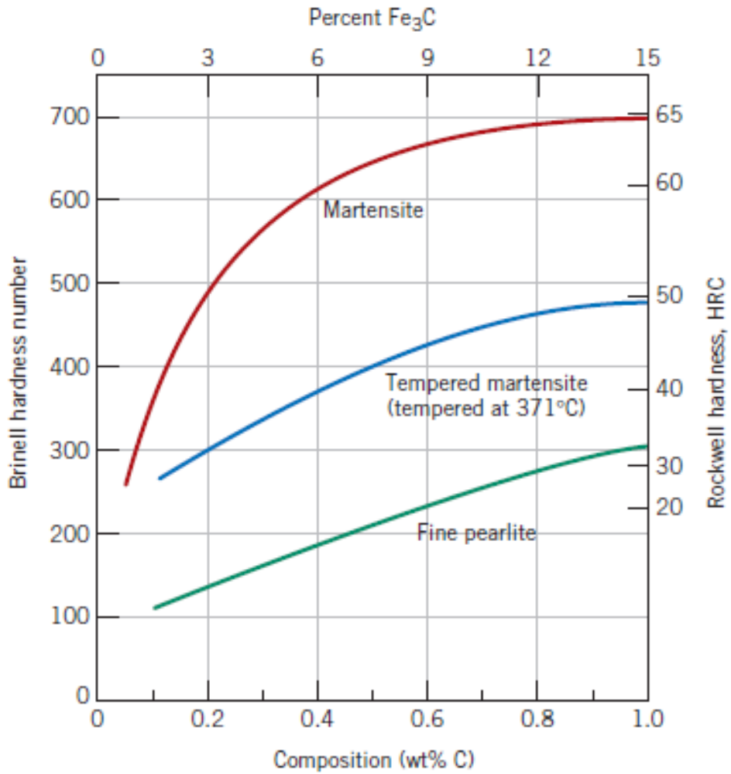
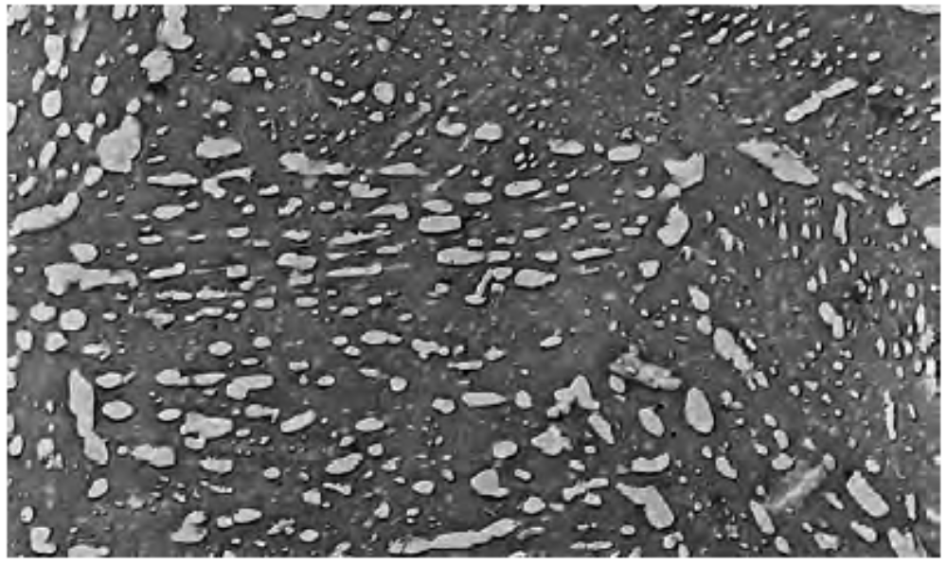
Mechanical Behaviour of Iron–Carbon Alloys
Tempered Martensite

Slide 19
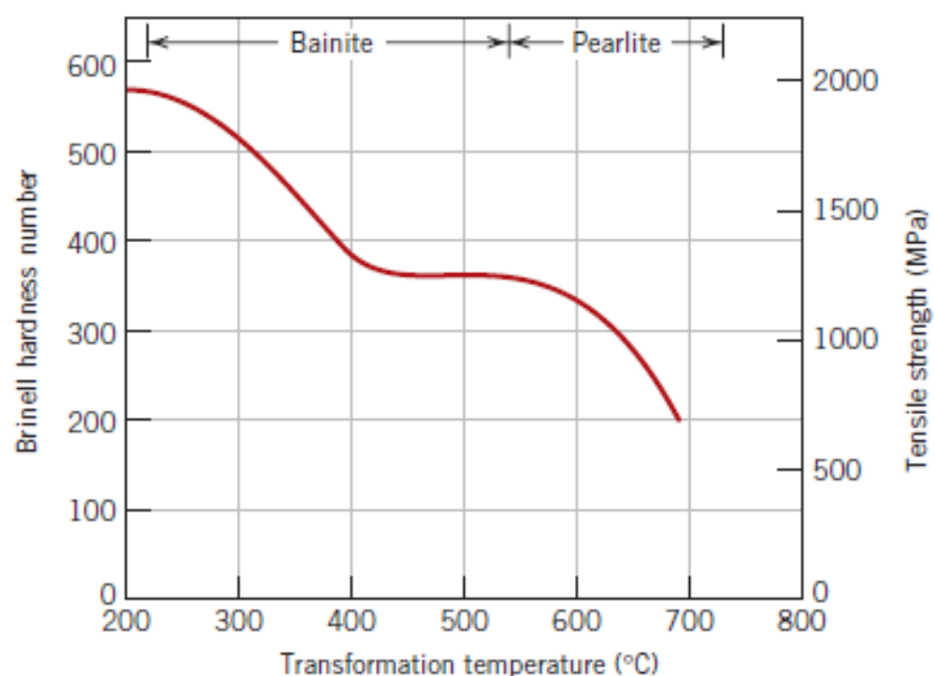
Mechanical Behaviour of Iron–Carbon Alloys
Bainite
Martensite and Tempered Martensite

Slide 20
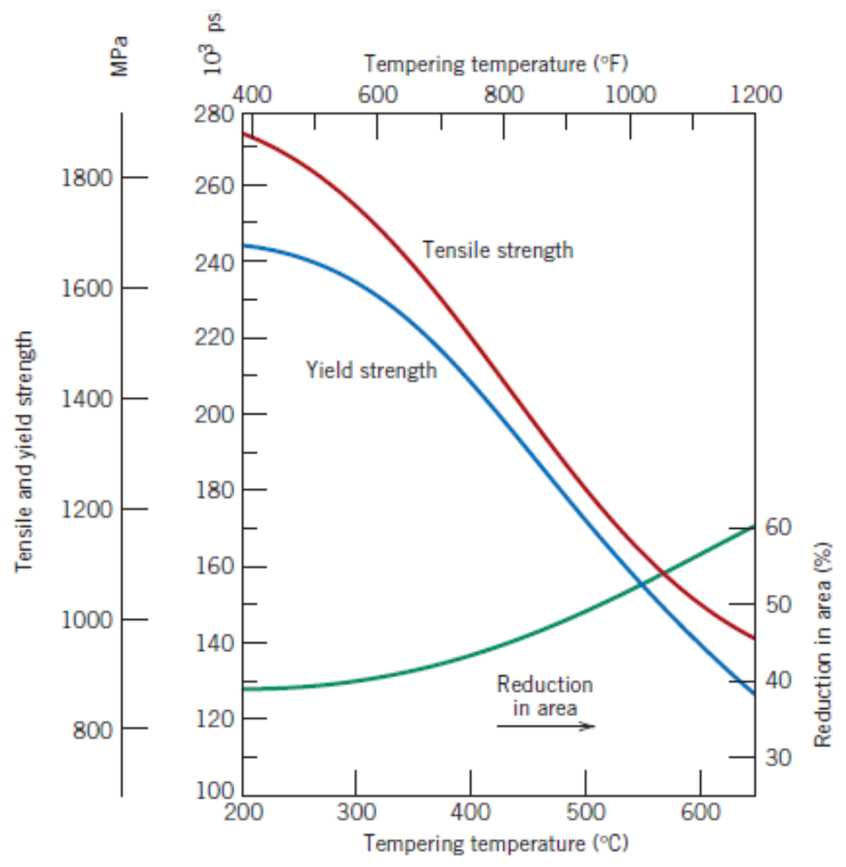
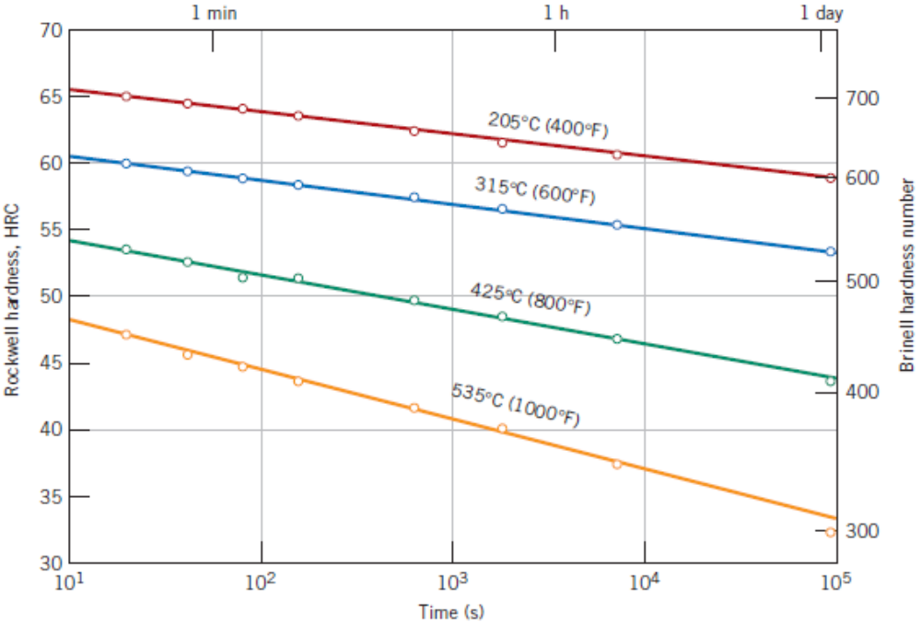
Mechanical Behaviour of Iron–Carbon Alloys
Tempered Martensite

Slide 21
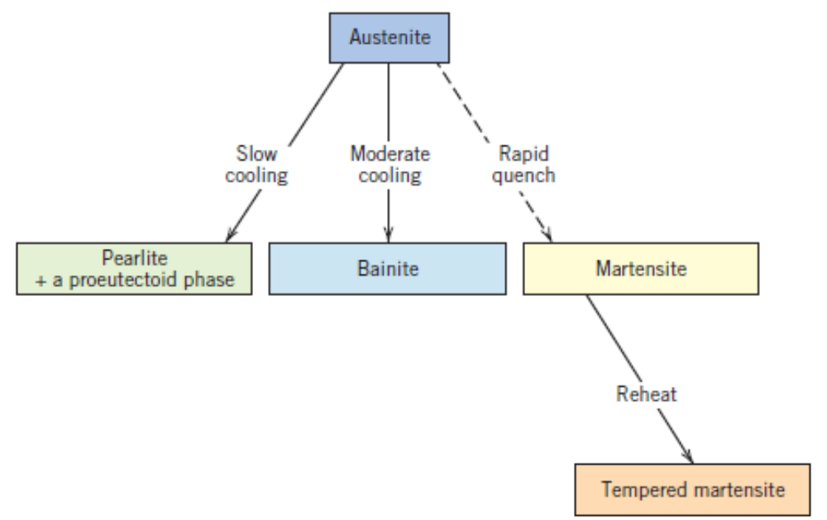
Review and Summary
Possible Phase Transformations

Slide 22
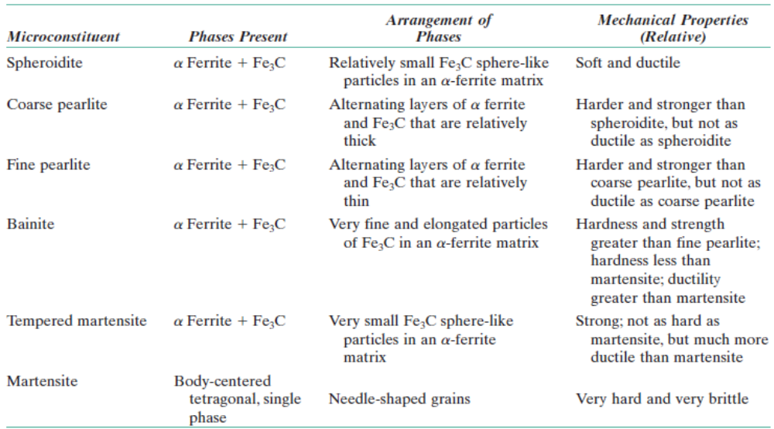
Review and Summary
Microstructures and their properties

